Slide 1
Exam 2 Review Chemical Equilibria and Acids & Bases
Geoffrey Geberth 10/1/18

Slide 2
Chemical Equilibria

Slide 3
Acids & Bases

Slide 4
Activity (a_{i})
Measure of how the free energy of a compound changes as a reaction proceeds
Unitless
Gas
$a_{i}=\frac{P_{i}}{P^{°}}$
Solutions
$a_{i}=\frac{\left[i\right]}{C^{°}}$
Pure solids and liquids
$a_{i}=1$

Slide 5
Mass Action Expression
xX$+bB⇄cC+dD$
$\frac{a_{C}^{c}a_{D}^{d}}{a_{X}^{x}a_{B}^{b}}$
Remember: Products/Reactants!
Can be done with concentrations or pressures
$\frac{{\left[C\right]}^{c}{\left[D\right]}^{d}}{{\left[X\right]}^{x}{\left[B\right]}^{b}}$
$\frac{P_{C}^{c}P_{D}^{d}}{P_{X}^{x}P_{B}^{b}}$
Remember: The standard state of a pure solid or liquid is 1
These expressions give us the Reaction Quotient (Q)

Slide 6
Equilibrium Constant
Value representing the reaction quotient when the system is at equilibrium
K > 1 -> favors products
K < 1 -> favors reactants
Can be huge or tiny, but is never negative
Different values for concentrations:
$K_{c}=$ $\frac{{\left[C\right]}^{c}{\left[D\right]}^{d}}{{\left[X\right]}^{x}{\left[B\right]}^{b}}$
$K_{p}=$ $\frac{P_{C}^{c}P_{D}^{d}}{P_{X}^{x}P_{B}^{b}}$
$K_{p}=K_{c}(RT)^{∆n}$
Arrived here from the ideal gas law (see gchem)

Slide 7
Manipulating K
There are 3 main ways we manipulate reactions and wish to know the new K
Reverse the reaction
$A+B⇌C \left(K_{1}\right)⟹C⇌A+B$
$\left(K_{2}=\frac{1}{K_{1}}\right)$
Multiply stoichiometric coefficients
$A+B⇌C \left(K_{1}\right)⟹$ $xA+xB⇌xC$
$\left(K_{2}=K_{1}^{x}\right)$
Add subsequent reactions
$A+B⇌C \left(K_{1}\right);C⇌D \left(K_{2}\right)⟹A+B⇌D$
$\left(K_{3}=K_{1}K_{2}\right)$

Slide 8
Q and K
Remember: Q is at any point in the reaction and moves, but K is only at equilibrium and is fixed (it depends on ΔG)
Comparing Q and K let’s us figure out in what direction a reaction will proceed, if at all
Q = K -> at equilibrium (forward rate = reverse rate)
Q < K -> Too many reactants (reaction produces more products)
Q > K -> Too many products (reaction produces more reactants)
K
Q

Slide 9
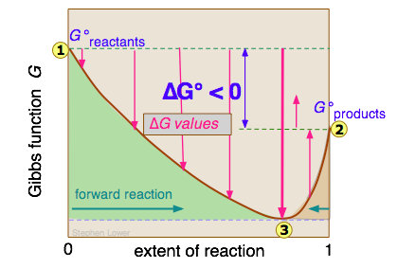
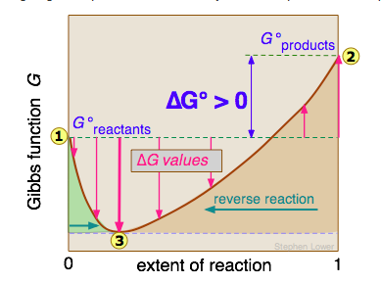
ΔG and Equilibria
At equilibrium, ΔG = 0
The sign on ΔG tells you which direction the reaction will move
ΔG < 0: Reaction moves to products
ΔG > 0: Reaction moves to reactants
$∆G={∆G}_{r}^{°}+RTln\left(Q\right)$
At any instant in the reaction
${∆G}_{r}^{°}=−RTln\left(K\right)$
At Eq
$K=e^{\frac{−∆G_{r}^{°}}{RT}}$

Slide 10
Let’s look at this equation more
$K=e^{\frac{−∆G_{r}^{°}}{RT}}$
If $∆G_{r}^{°}=0, K=1$
Temperature can change the equilibrium point!
Direction depends on $∆H_{rxn}$
Endothermic (ΔH > 0), increased T increases K
Exothermic (ΔH < 0), increased T decreases K

Slide 11
RICE tables
How we solve for changes in a system towards equilibrium
R: Reaction
I: Initial Conditions
C: Change
E: Equilibrium
Example: $A+B⇌2C$ initially at .1 M in A and B (no C present)

Slide 12
Van’t Hoff Equation
$\ln{\frac{K_{2}}{K_{1}}=\frac{∆H}{R}\left(\frac{1}{T_{1}}−\frac{1}{T_{2}}\right)}$
Laid out just like Clausius-Clapeyron Eqn.
Used to find K at new temperatures
Make sure you use the right units of R and keep your T’s and K’s in agreement!

Slide 13
Definitions
Arrhenious
Acid produces $H_{3}O^{+}$ ions in water
Base produces ${OH}^{−}$ ions in water
Bronsted-Lowry
Acid is a proton donor
Base is a proton acceptor
Lewis
Acid is an electron pair acceptor
Base is an electron pair donor

Slide 14
Auto-ionization of Water
Water is naturally an equilibrium
$2H_{2}O\left(l\right)⇌H_{3}O^{+}\left(aq\right)+{OH}^{−}(aq)$
$K_{w}=\left[H_{3}O^{+}\right]\left[{OH}^{−}\right]=1∗{10}^{−14} at room temperature!$
$$\left[H_{3}O^{+}\right]=\left[{OH}^{−}\right]$$ | Neutral
$$\left[H_{3}O^{+}\right]>\left[{OH}^{−}\right]$$ | Acidic
$$\left[H_{3}O^{+}\right]<\left[{OH}^{−}\right]$$ | Basic

Slide 15
Strong vs. Weak Acids and Bases
Strong compounds dissociate completely
Weak compounds do not completely dissociate
Know your strong acids and bases!
Strong acids/bases have weak conjugate bases/acids!
Proven by comparing K_{a} and K_{b}
Strong Acids | Strong Bases
Hydrochloric acid (HCl) | Lithium hydroxide (LiOH)
Hydrobromic acid (HBr) | Sodium hydroxide (NaOH)
Hydroiodic acid (HI) | Potassium hydroxide (KOH)
Perchloric acid (HClO₄) | Rubidium hydroxide (RbOH)
Chloric acid (HClO₃) | Cesium hydroxide (CsOH)
Sulfuric acid (H₂SO₄) (Only the first proton is strong) | Calcium hydroxide (Ca(OH)₂)
Nitric acid (HNO₃) | Strontium hydroxide (Sr(OH)₂)
 | Barium hydroxide (Ba(OH)₂)

Slide 16
Acid vs Base dissociation
Acid
$HA\left(aq\right)+H_{2}O\left(l\right)⇌H_{3}O^{+}\left(aq\right)+Cl^{−}(aq)$
Equilibrium governed by K_{a}
Base
$BOH\left(s\right)⇌B^{+}\left(aq\right)+OH^{−}(aq)$
Equilibrium governed by K_{b}
Interconvert using K_{w}
$K_{w}=K_{a}K_{b}$

Slide 17
Acid Base Equilibria
Handle just like a chemical equilibrium
RICE tables!
Make sure you know what reaction you’re looking at and whether it requires K_{a} or K_{b}
Keep The Assumption in mind
Many problems boil down to $K=\frac{x^{2}}{C−x}$
If $\frac{C}{K}>1000$, we can assume $C−x≈C$, and we don’t need to solve using a quadratic

Slide 18
Measures of Acidity and Basicity
pH and pOH
$−\log\left[H^{+}\right]$and $−\log\left[{OH}^{−}\right]$ respectively
Typically between 1 and 14
7 is neutral
Smaller pH = more acidic
Larger pH = more basic (just remember to ‘turn up the base!’)
$\left[H^{+} or {OH}^{−}\right]=e^{−pH or pOH}$
K_{a or b}
The larger the number, the stronger the acid or base (depending on a or b)

Slide 19
% ionization
The fraction of the original compound that is ionized
$\% ionized= \frac{\left[ion\right]}{\left[initial compound\right]}∗100\%$
If the same compound is dissolved at two different concentrations, it will yield different % ionizations!

Slide 20
Let’s practice!
Geoff was out celebrating the UT victory over Oklahoma (HOOK ‘EM!) while out of town in Pittsburgh when he noticed that it was starting to rain, but the rain felt kind of funny. It was acid rain! Acid rain forms from atmospheric sulfuric and nitric acid. In this case, we will assume pure nitric (HNO₃). If the pH is 4.3 and the volume of a raindrop is 0.05 mL, how many moles of HNO₃ are dissolved in each raindrop?
We know Nitric acid is a strong acid, so it fully dissociates
We need the concentration of H⁺
$$pH=−\log\left[H^{+}\right]→\left[H^{+}\right]={10}^{−pH}$$
$$={10}^{−4.3}=5.01∗{10}^{−5} M$$
$$⟶5.01∗{10}^{−5} M∗.05 mL ∗\frac{1L}{1000 mL}$$
$$=2.5∗{10}^{−9} moles per raindrop!$$

Slide 21
Let’s stick with the rain theme!
Geoff was inspired by this to try to create purple rain! He found a base (B) that when dissolved in water produces a purple color (K_{B} = 1.2*10⁻⁵) and started wondering what concentration it would take to make basic rain (pOH = 4.3)…
Start with a RICE table!
$$pOH=−\log\left[{OH}^{−}\right]→\left[{OH}^{−}\right]={10}^{−pOH}={10}^{−4.3}=5.01∗{10}^{−5} M$$
$$K_{B}=\frac{\left[{BH}^{+}\right]\left[{OH}^{−}\right]}{\left[B\right]}=\frac{(5.01∗{10}^{−5})(5.01∗{10}^{−5})}{(?−5.01∗{10}^{−5})}=1.2∗{10}^{−5}$$
$$→1.2∗{10}^{−5}\left(?−5.01∗{10}^{−5}\right)=2.5∗{10}^{−9}$$
$$⟶?=2.6∗{10}^{−4} M!$$
B + | H₂O <-> | BH⁺ + | OH⁻
? | - | 0 | 0
-X | - | +X | +X
? – 0.014 M | - | 0.014 M | 0.014 M

Slide 22
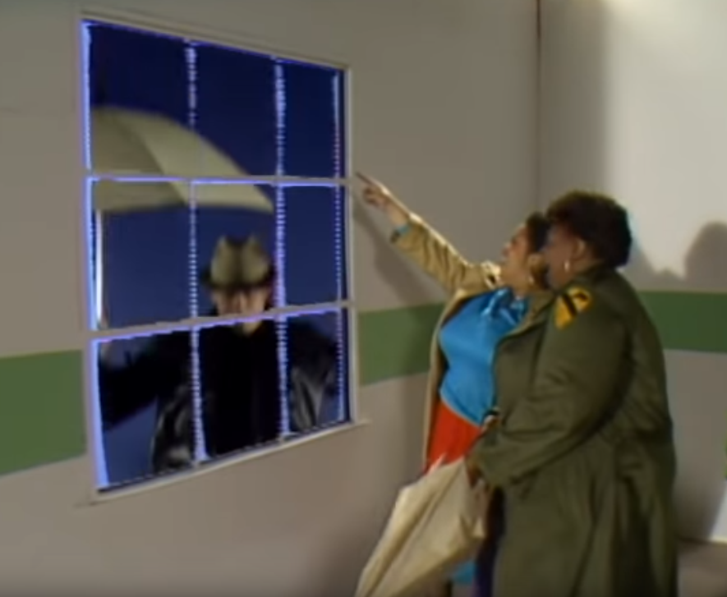
Who’ll Stop the Rain?!
IT’S RAINING MEN!
While preparing his purple rain solution, he looked outside and noticed something. The weather had changed again…
(Hallelujah!)
Image taken from the offical music video for It’s Raining Men by the Weather Girls. I do not own any rights to the song or video. I am citing under academic fair use.

Slide 23
Time for a tough problem!
After referencing his CRC Handbook of Chemistry, Physics, and the 80’s, Geoff learned that ‘Men⁻’ are actually the conjugate base of the weak acid ‘HMen’ that, when solvated in water produces the following equilibrium: $HMen \left(aq\right)+ H_{2}O\left(l\right)⇌H_{3}O^{+}+{Men}^{−}$. (K_{A}= 3.5*10⁻⁴) If I start with 0.05 M HMen
Find the following:
K_{B} of the conjugate base
The pH
The equilibrium concentrations of HMen and OH⁻ (in the water)
The percent ionization

Slide 24
Time for a tough problem!
After referencing his CRC Handbook of Chemistry, Physics, and the 80’s, Geoff learned that ‘Men⁻’ are actually the conjugate base of the weak acid ‘HMen’ that, when solvated in water produces the following equilibrium: $HMen \left(aq\right)+ H_{2}O\left(l\right)⇌H_{3}O^{+}+{Men}^{−}$. (K_{A}= 3.5*10⁻⁴) If I start with 0.05 M Hmen
Find K_{B}
$$K_{B}=\frac{K_{W}}{K_{A}}=\frac{1∗{10}^{−14}}{3.5∗{10}^{−4}}=2.9∗{10}^{−11}$$
The pH
Start with a RICE table!

Slide 25
Time for a tough problem!
After referencing his CRC Handbook of Chemistry, Physics, and the 80’s, Geoff learned that ‘Men⁻’ are actually the conjugate base of the weak acid ‘HMen’ that, when solvated in water produces the following equilibrium: $HMen \left(aq\right)+ H_{2}O\left(l\right)⇌H_{3}O^{+}+{Men}^{−}$. (K_{A}= 3.5*10⁻⁴) If I start with 0.05 M Hmen
$$K_{A}=3.5∗{10}^{−4}=\frac{\left[H_{3}O^{+}\right]\left[{Men}^{−}\right]}{\left[HMen\right]}=\frac{(X)(X)}{(0.05−X)}$$
Check the Assumption: $\frac{C_{HMen}}{K}=\frac{0.05}{3.5∗{10}^{−4}}$
$=143$! It’s Quadratic time!
HMen (aq) + | H₂O (l) <-> | H₃O⁺ (l)+ | Men⁻
0.05 M | - | 0 | 0
-X | - | +X | +X
0.05 - X | - | X | X

Slide 26
Time for a tough problem!
After referencing his CRC Handbook of Chemistry, Physics, and the 80’s, Geoff learned that ‘Men⁻’ are actually the conjugate base of the weak acid ‘HMen’ that, when solvated in water produces the following equilibrium: $HMen \left(aq\right)+ H_{2}O\left(l\right)⇌H_{3}O^{+}+{Men}^{−}$. (K_{A}= 3.5*10⁻⁴) If I start with 0.05 M Hmen
$$K_{A}=3.5∗{10}^{−4}=\frac{\left[H_{3}O^{+}\right]\left[{Men}^{−}\right]}{\left[HMen\right]}=\frac{(X)(X)}{(0.05−X)}$$
$$X^{2}+3.5∗{10}^{−4}\left(X\right)−\left(1.75∗{10}^{−5}\right)=0$$
$$X=\frac{−b±\sqrt{b^{2}−4AC}}{2A}$$
$$=\frac{−3.5∗{10}^{−4}+\sqrt{{\left(3.5∗{10}^{−4}\right)}^{2}−4(1)(−1.75∗{10}^{−5})}}{2(1)}$$
$$=4.0∗{10}^{−3}=X=\left[H_{3}O^{+}\right]$$
$$→pH=−\log{4.0∗{10}^{−3}=2.4}$$

Slide 27
Time for a tough problem!
After referencing his CRC Handbook of Chemistry, Physics, and the 80’s, Geoff learned that ‘Men⁻’ are actually the conjugate base of the weak acid ‘HMen’ that, when solvated in water produces the following equilibrium: $HMen \left(aq\right)+ H_{2}O\left(l\right)⇌H_{3}O^{+}+{Men}^{−}$. (K_{A}= 3.5*10⁻⁴) If I start with 0.05 M HMen
Find the following:
The equilibrium concentrations of HMen and OH⁻ (in the water)
From our RICE table: $\left[HMen\right]=\left(0.05−X\right)$
$$=\left(0.05−4∗{10}^{−3}\right)=0.046M$$
$$K_{W}=\left[H_{3}O^{+}\right]\left[{OH}^{−}\right]→\left[{OH}^{−}\right]=\frac{K_{W}}{\left[H_{3}O^{+}\right]}$$
$$=\frac{1∗{10}^{−14}}{4.0∗{10}^{−3}}=2.5∗{10}^{−12}$$

Slide 28
Time for a tough problem!
After referencing his CRC Handbook of Chemistry, Physics, and the 80’s, Geoff learned that ‘Men⁻’ are actually the conjugate base of the weak acid ‘HMen’ that, when solvated in water produces the following equilibrium: $HMen \left(aq\right)+ H_{2}O\left(l\right)⇌H_{3}O^{+}+{Men}^{−}$. (K_{A}= 3.5*10⁻⁴) If I start with 0.05 M HMen
Find the following:
The percent ionization
$$\% ionized= \frac{\left[{Men}^{−}\right]}{\left[HMen (initial)\right]}∗100\%$$
$$\% ionized= \frac{4∗{10}^{−3}}{0.05}∗100\%$$
$$=8\%$$
Those were actually numbers for HF, but that’s a lot less fun and a lot more dangerous.

Slide 29
Good Luck Studying!

